Slide 1
Path forward: Getting to zero carbon equitably
Srinidhi Sampath Kumar
Sustainable Housing Policy and Program Manager
ssampath@chpc.net
Jan 24th, 2020

Slide 2
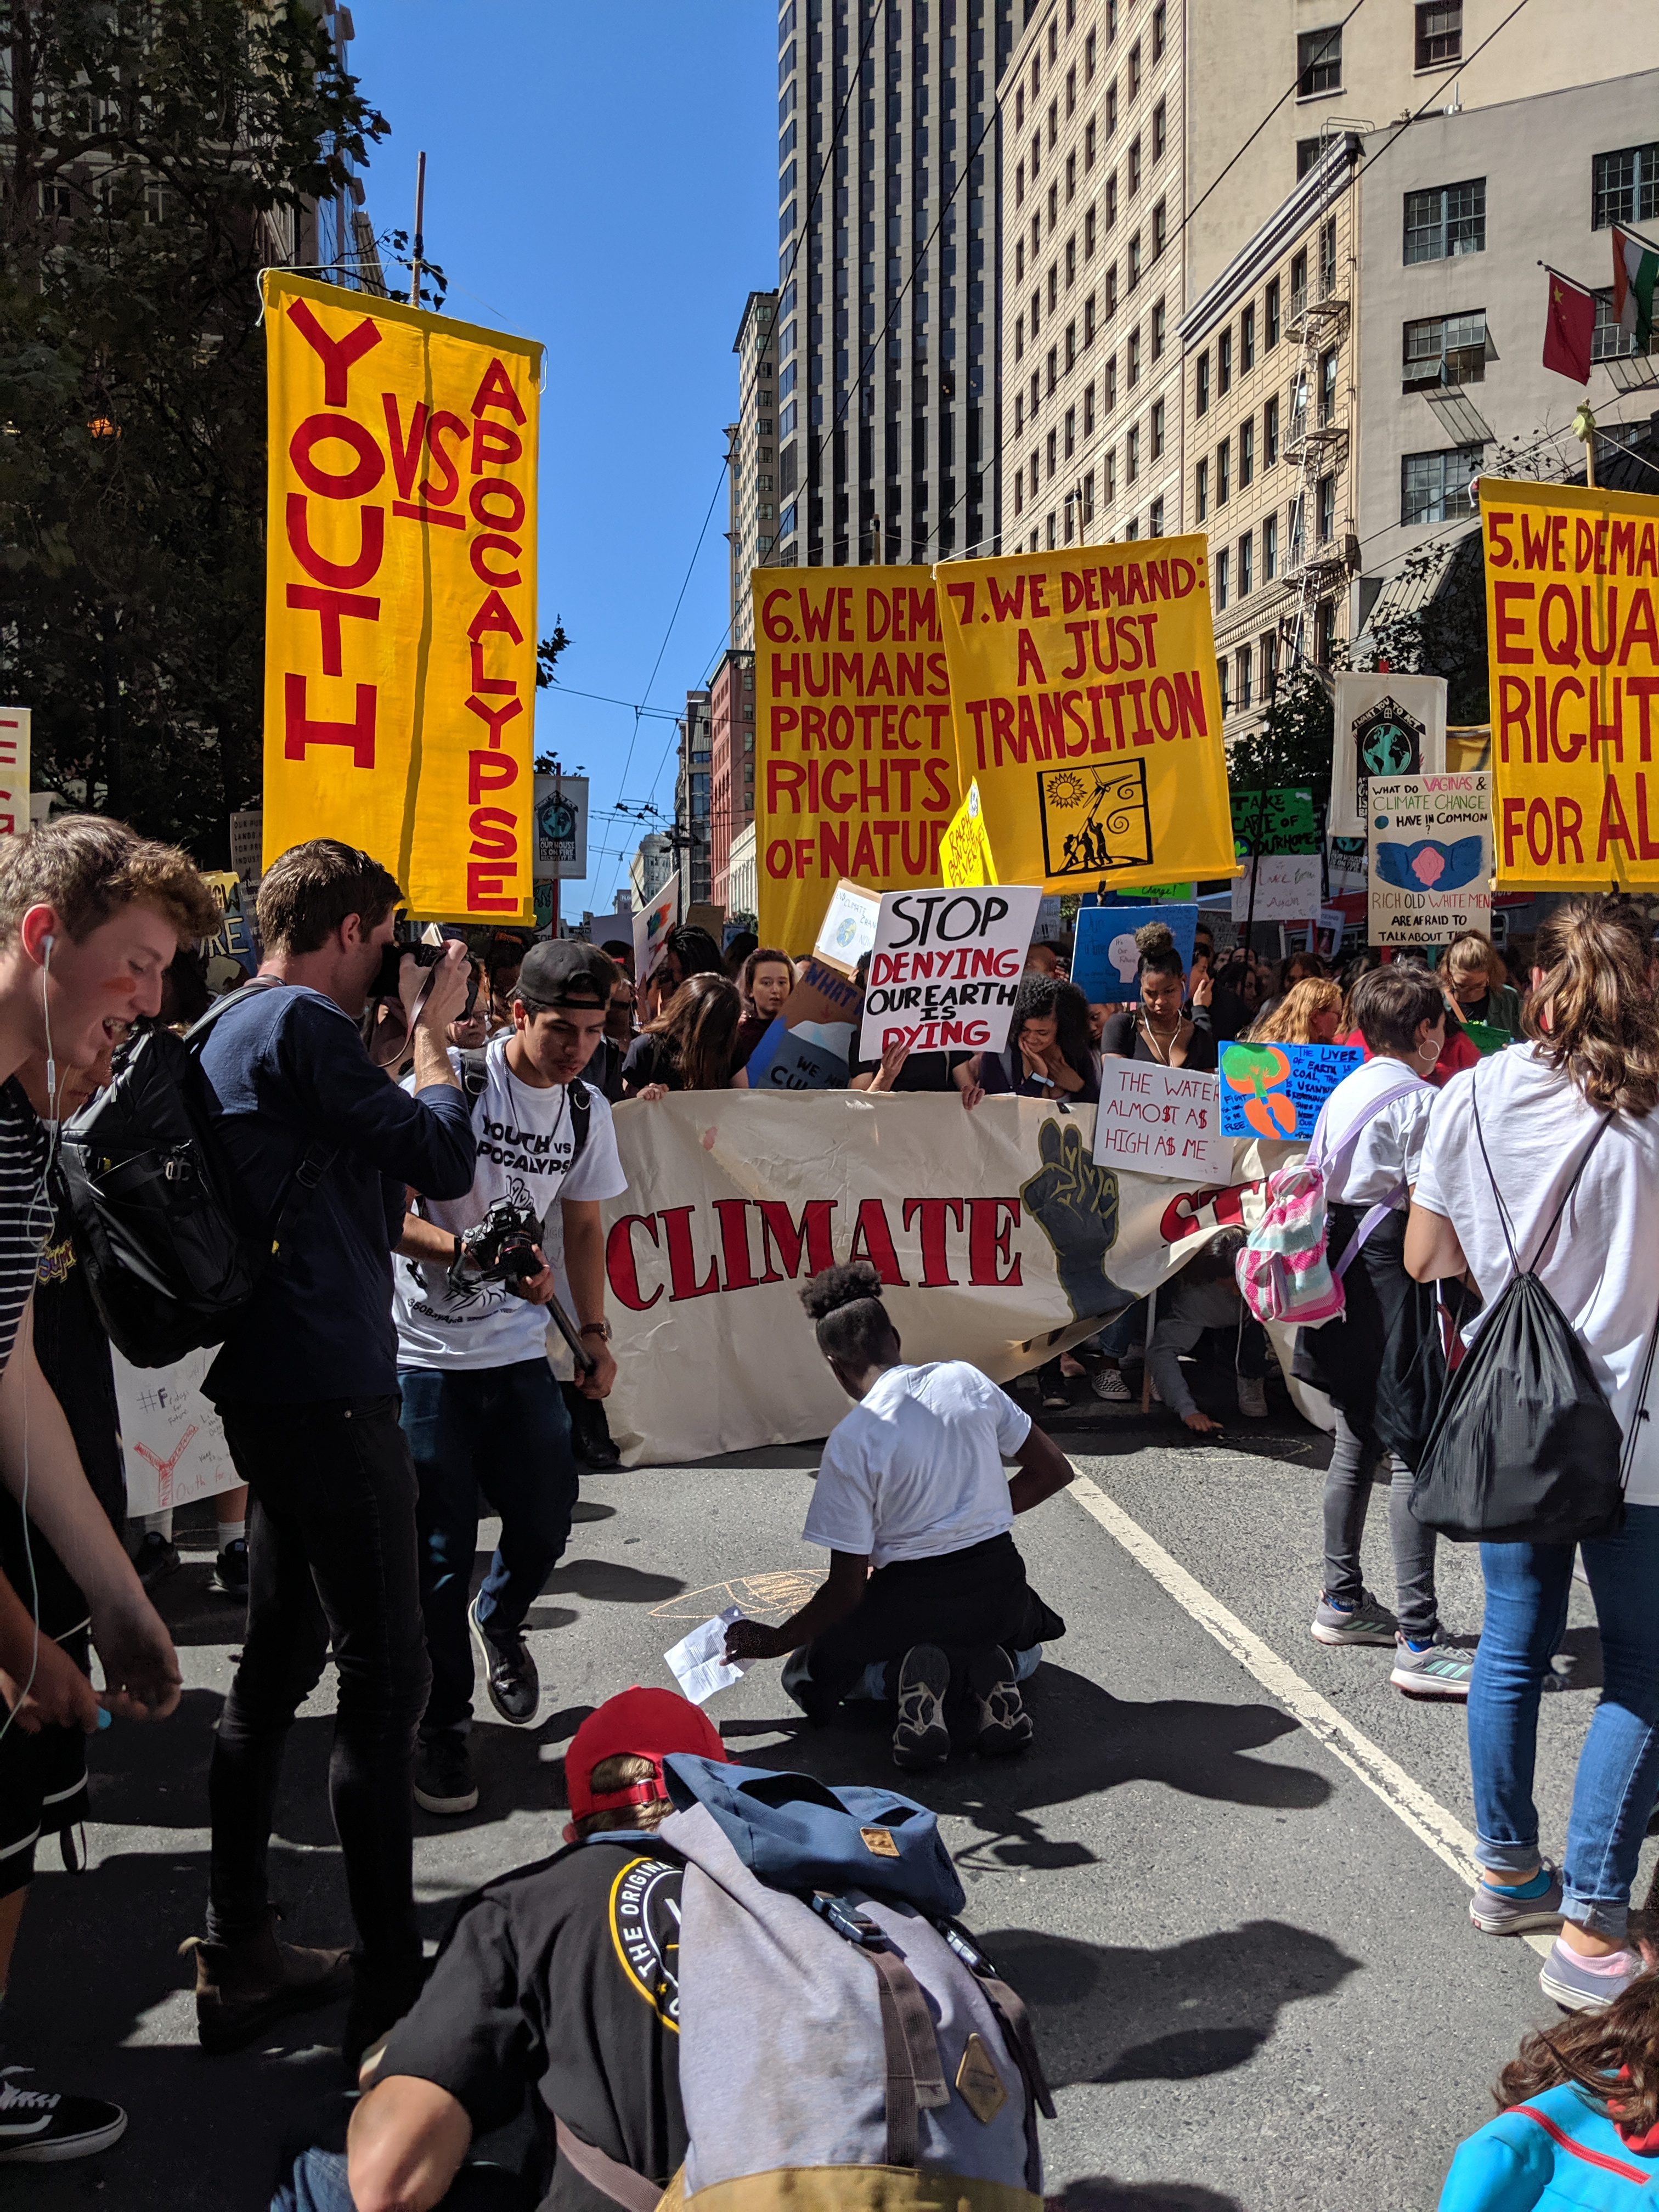
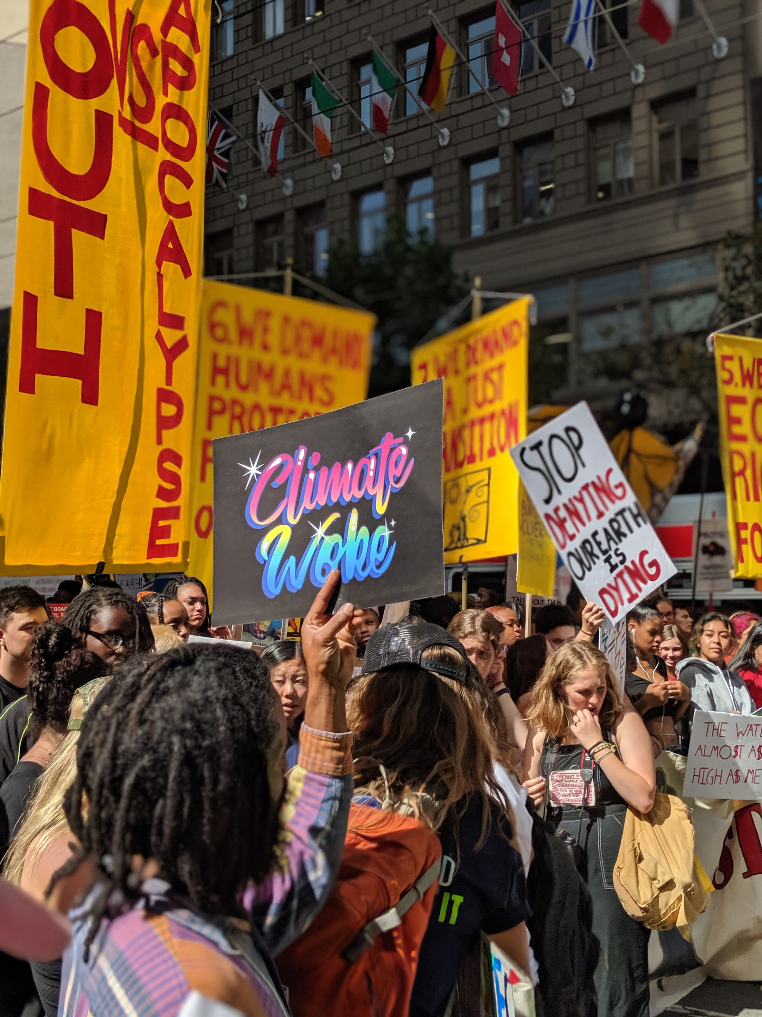
Why electrify?

Slide 3
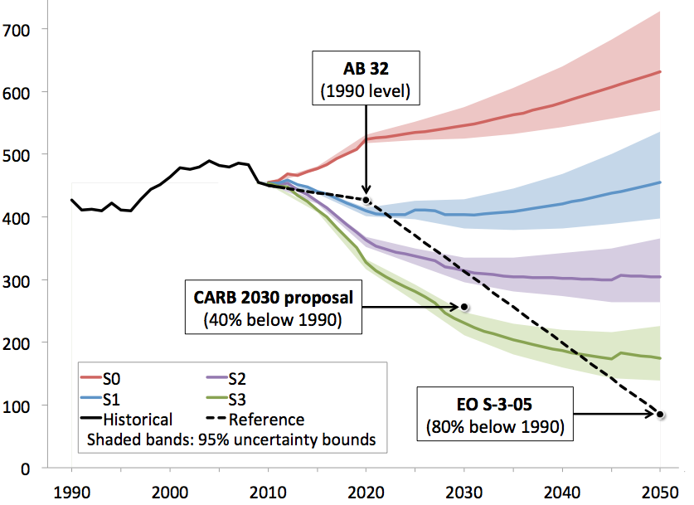
Why electrify?
California committed to reducing GHG emissions 80% by 2050
To reach carbon neutrality by 2045, all buildings will need to be all-electric
Notes:
In 2016, California building energy use was responsible for more than 26% of statewide greenhouse gas emissions.
California has adopted aggressive greenhouse gas emission reduction targets, including returning to 1990 levels by 2020, 40% below 1990 by 2030, and carbon neutrality by 2045.

Slide 4
Why electrify?
Gas infrastructure, stranded assets
Considerable increase in gas rates
Health concerns
Increasing climate related emergencies
Programs and incentives that support electrification in low-income multifamily buildings but largely for existing buildings
Notes:
As more buildings move off of gas, fewer and fewer customers will share burden of fixed system costs, making gas very expensive
LIWP, SOMAH, SGIP ---- AHSC AND SB 1477
Given all this, I know several of you are already trying to electrify your buildings. Our expert panelists are here to discuss when and how to plan for it, what are the barriers and provide ideas and creative solutions on how to stay on top of it.

Slide 5
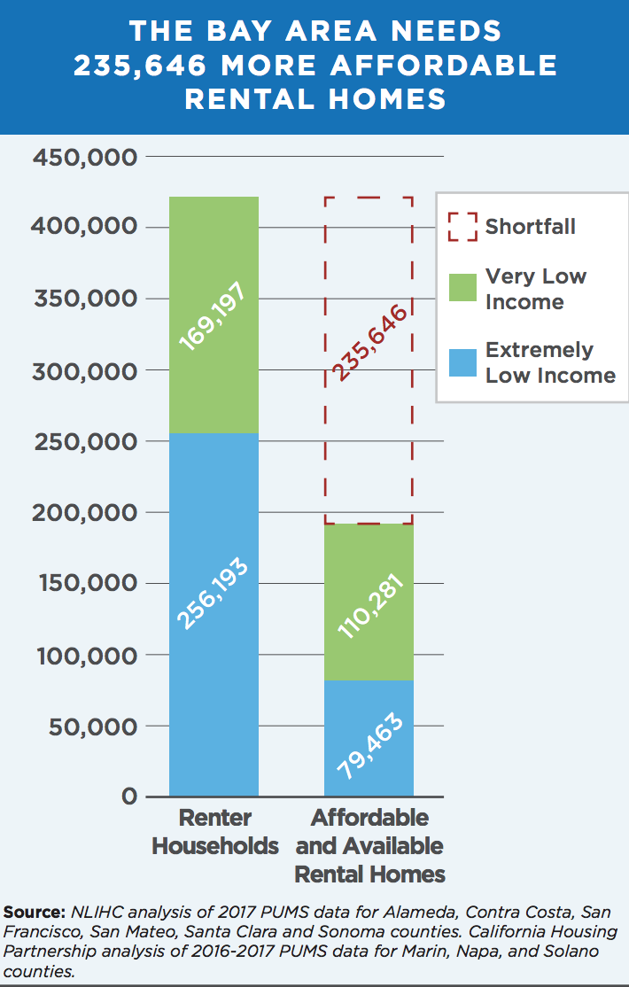
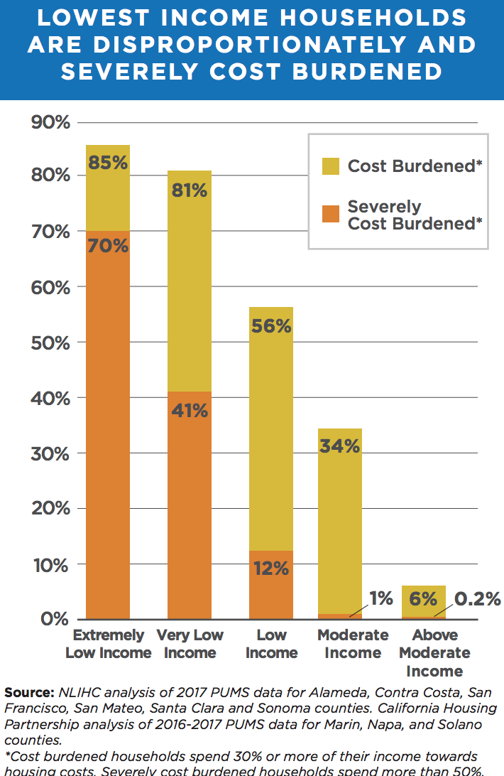
What are we waiting for then?
Notes:
San Mateo 97% of AMI Needed to Afford Modest Rent

Slide 6
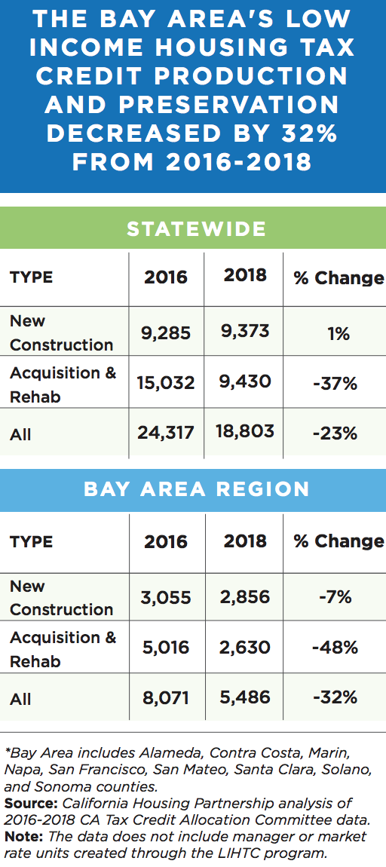
Housing Financing Landscape and Other Costs Considerations
Federal and State housing funds drying up
Construction costs + operating expenses + replacement reserve
Difficulty in reaching economies of scale
Utility Allowance versus rent increases (who bears the costs?)
However, may incentivize less consumption especially in previously master metered properties
Notes:
State tax credits go quick- only about 40 properties gets constructed every year- so production is already low
HCED funds are drying up in 3-4 years including No Place Like Home and Veterans Homeless Housing Program
However, AHSC is still available and has a really good potential
First cost differential

Slide 7
Other Challenges
Developer size
Property size
Portfolio region and disparate local reach codes
Maintenance staff and vendors
Availability of equipment that have operating history, contractor availability and experience, willingness of the team
Equipment challenges: central domestic hot water and laundry systems
Resilience during shut offs and storage issues
System Sizing issues
Notes:
Keeping up with the pace of change- staff capacity and organizational financial stability
Few maintenance vendors
Construction schedule and sticking with the timeline
Working out the kinks in operation
Sizing including for ev, storage can be underestimated

Slide 8
Recommendations
T24 should reflect local reach codes and local reach codes should be more uniform across cities
Housing programs should keep up with the States path towards decarbonization
Just more funding (like SB 1477)
Guidance document for property managers on how to be decarb ready
Resident training and user experience
Contractor training and approved contractors list
Training code enforcement officials
Pilot decarb buildings in different regions and track costs gaps
Keep focus on core goals of providing affordable housing
Notes:
No property owner who is working on a new construction wants to willingly put in gas. They all see the importance of removing gas from buildings.
But this needs to be done with more input directly received from property managers, and from asset managers and staff who work in the property
so property owners with portfolio across different cities can manage more easily

Slide 9
Resources
California Housing Partnership Housing Needs Assessment and Who Can Afford to Rent in California’s Many Regions https://chpc.net/resources-library
Equitable Building Electrification: A Framework For Powering Resilient Communities
https://greenlining.org/publications/reports/2019/equitable-building-electrification-a-framework-for-powering-resilient-communities/

